Slide 1
Logical Decisions in Matlab
Week 9
Day 33

Slide 2
Logical Operators in Matlab
Relational Operators
= = | Equal to
< | Less than
> | Greater than
<= | Less than or equal to
>= | Greater than or equal to
~ = | Not equal to
NOTE: Double-equals for testing equality (Different from VBA!)
Logical Operators
& | And
| | Or
~ | Not

Slide 3
In-Class Exercise #1
Matlab relational operators can be used in a formula outside of an If structure.
In the command window, use relational operators to create a variable which contains the True/False (Boolean) answer to the following questions…
Is 2 > 1 ?
Solution: >> L = 2 > 1
Boolean values are represented in Matlab by 1 for True, 0 for False
Are both 2 > 1 and 3 < 3 true? (And)
Is at least one of 2 > 1 and 3 < 3 true? (Or)

Slide 4
In-Class Exercise #2
Matlab relational operators can be used to filter values in arrays.
In the command window, use relational operators to modify the array a=[1:10];
Which elements are less than 5?
Solution: >> l = a < 5
Boolean values are represented in Matlab by 1 for True, 0 for False
Make a new array, b, which contains the same number of elements as a, but only contains the values of a less than 5.

Slide 5
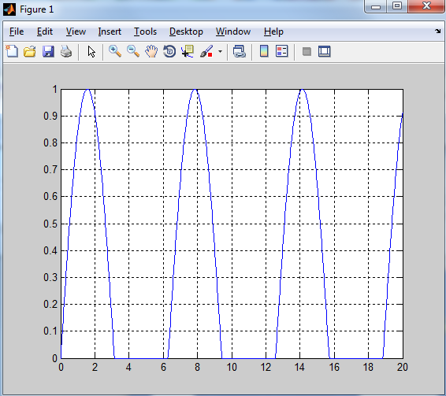
In-Class Exercise #3
Write a script to plot only the positive portions of sin(x) from x = 0 to 20.

Slide 6
Logical/Decision Statements: If/Then – ElseIf – Else
If – Then – Else structure very similar to VBA (except no “Then”, and just “End” instead of “End If”)
if (condition1)
Statements to run if condition1 is true
elseif (condition2)
Statements to run if condition2 is true
elseif (condition3)
…
else
Statements to run if all conditions are false
end

Slide 7
In-Class Exercise #4
Recollect the following in-class problem in VBA. Evaluate the following function for a given value of x given by user:
If x is not within either of the ranges defined above, display the message “x is out of range.”

